Slide 1
From “If not me, then who?” to “I have a dream…”
January advisory

Slide 2
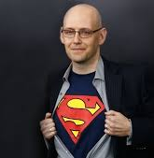
Brad Metzler:
1. Dream big
2. Work hard (fight failure)
3. Be humble

Slide 3
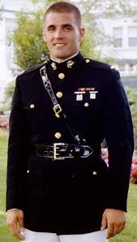
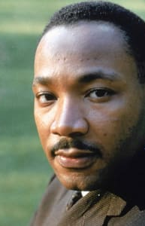
Write your story to change history!

Slide 4


Slide 5
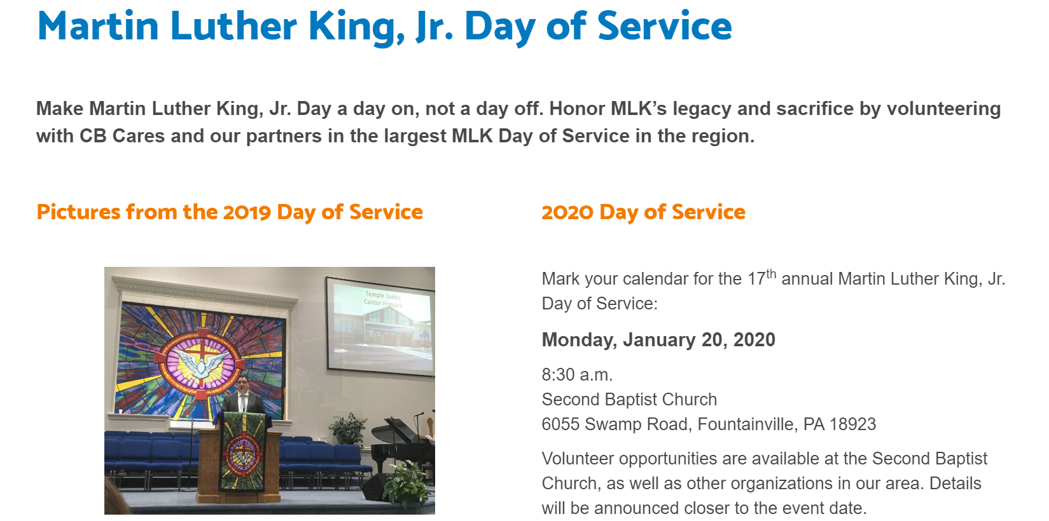

Slide 6

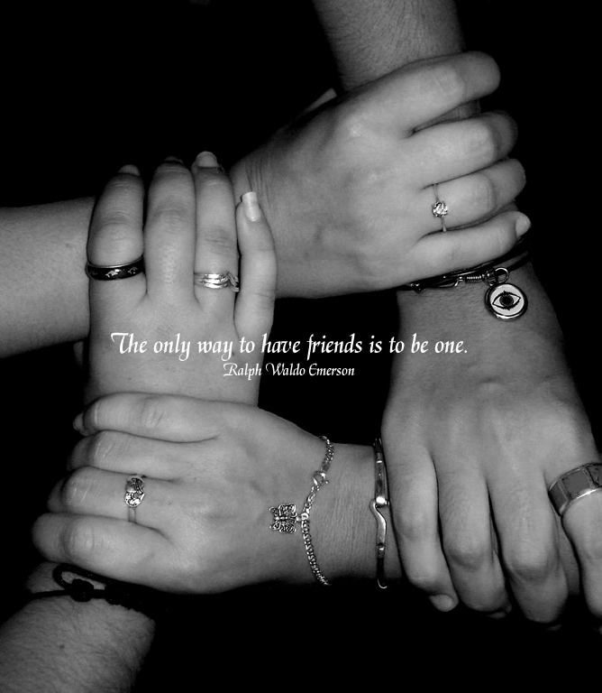

Bucks County Family Friends
This is local, the Bucks County Intermediate Unit in Doylestown.
Can volunteer at any age.
You just need to be a friend to a family that has a child with a physical, mental or a social disability.
Activities with the family might include, playing games, reading a book, or just hanging out and talking.

Slide 7
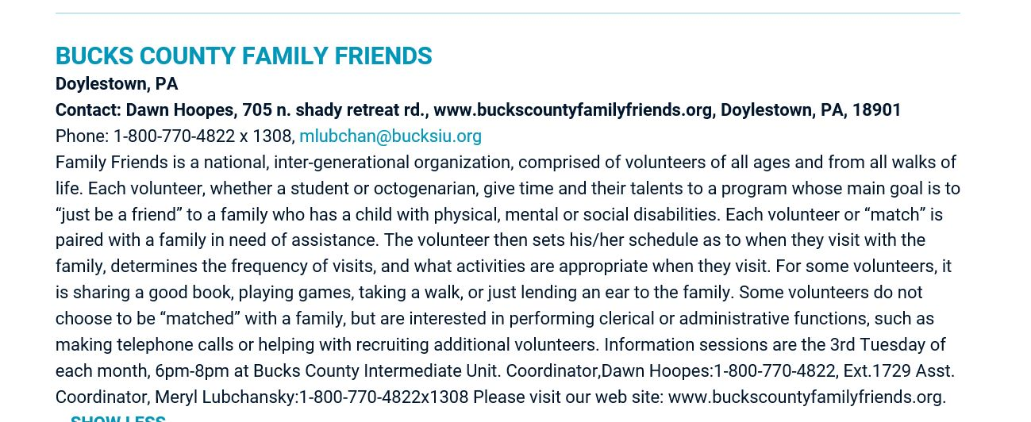

Slide 8


Bucks County Free Library
150 S. Pine Street
Doylestown, PA
18901-4932
Phone: (215) 348-9081
Mission: The Bucks County Free Library is a seven-branch county library system with locations in Bensalem, Doylestown, Langhorne, Levittown, Perkasie, Quakertown, and Yardley-Makefield. The county library system was founded in 1956 by a resolution of the Bucks County Commissioners.

Slide 9

Bucks County Free Library
150 S. Pine Street
Doylestown, PA
18901-4932
Phone: (215) 348-9081
Our age requirement for teens
is that they be in 7th-12th grade:
They help with shelving materials
Running children's activities
Manning the Reading Log Table
Go to calendar at www.buckslib.org
The choose the Doylestown branch
On the pull dpwn menu to receive the correct info!

Slide 10
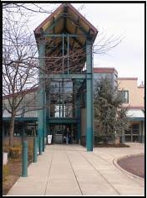
Bucks County Free Library
150 S. Pine Street
Doylestown, PA
18901-4932
Phone: (215) 348-9081
The next Teen Volunteer Orientation
will be January 9th, but we hold
orientations a few times each season,
And we always have two in May and
June as we get ready for the summer programs!
In general, we are looking for volunteers who want to volunteer on a regular basis over a longer period of time, rather than volunteering many hours in a short period of time. In the summer especially, we look for volunteers enjoy working with children.
Emily Knorr
Youth Services Librarian
Bucks County Free Library, Doylestown Branch

Slide 11




Meals on Wheels
Our Mission:
We deliver fresh, individually prepared, nutritious meals to members of our community who are seniors, handicapped, or otherwise challenged to provide their own food.

Slide 12
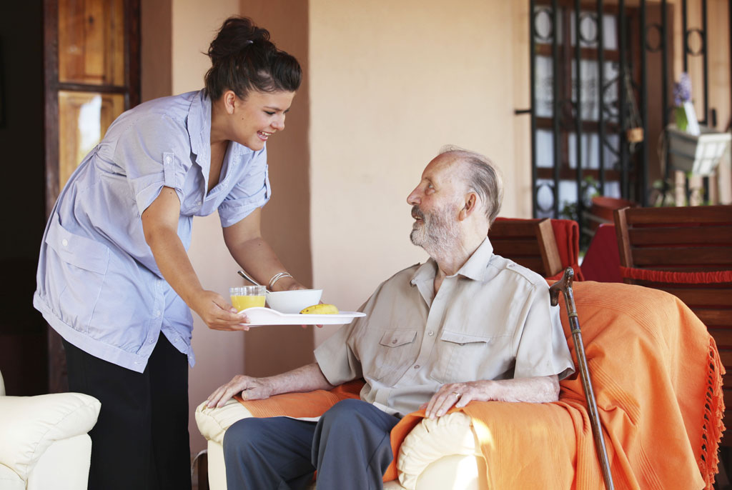
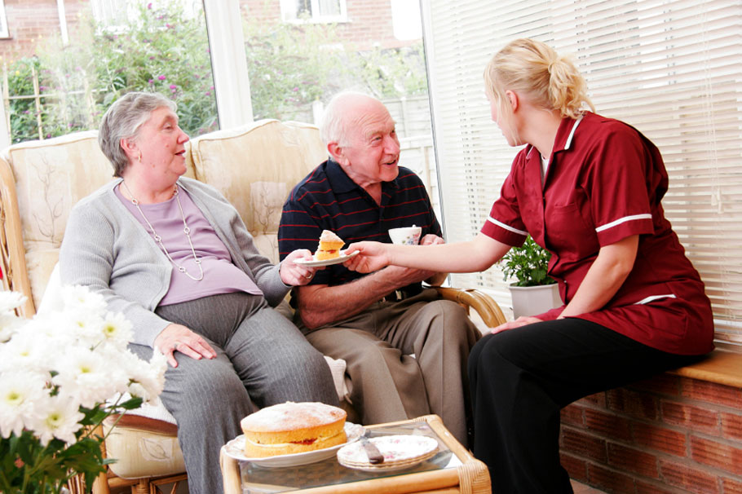
Meals on Wheels
Dear Meals on Wheels,
Thank you for sharing your very special culinary skills and talents with me by providing me with your delicious food. Everything is so tasteful and nutritious. I am most grateful. God bless you. Many thanks to your efficient and wonderful volunteers.
Sincerely, – M.B.

Slide 13
Meals on Wheels
Volunteer Opportunities: We need 24 volunteers everyday, Monday through Friday, to assist in the preparation and delivery of meals to homebound seniors. A commitment to help once or twice a month is all that is needed to help carry out our mission. Current volunteers include at-home moms and dads, retirees, and working men and women with the flexibility to arrange their schedules.
Contact: Mary Danzis
252 Belmont Ave., Doylestown, PA 18901
215-345-6065
http://www.cbmealsonwheels.org
http://www.cbmealsonwheels.org/volunteer

Slide 14

New Hope Celebrates
New Hope Celebrates brings people together to share in a celebration of our history, diversity and the inclusiveness of our community. We have a need for year-round volunteers!
https://www.newhopecelebrates.com/about/volunteer/
Students may receive a letter of completion of community service.

Slide 15
New Hope Celebrates
Upcoming Events:
Workshop for Youth Involvement
Pride 5K Run & 1 Mile Walk
Pride Festival
Pride Parade https://www.newhopecelebrates.com/about/volunteer/

Slide 16
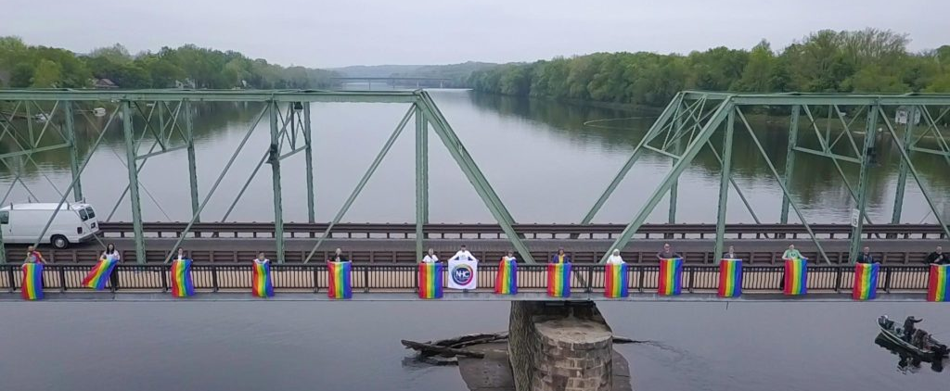
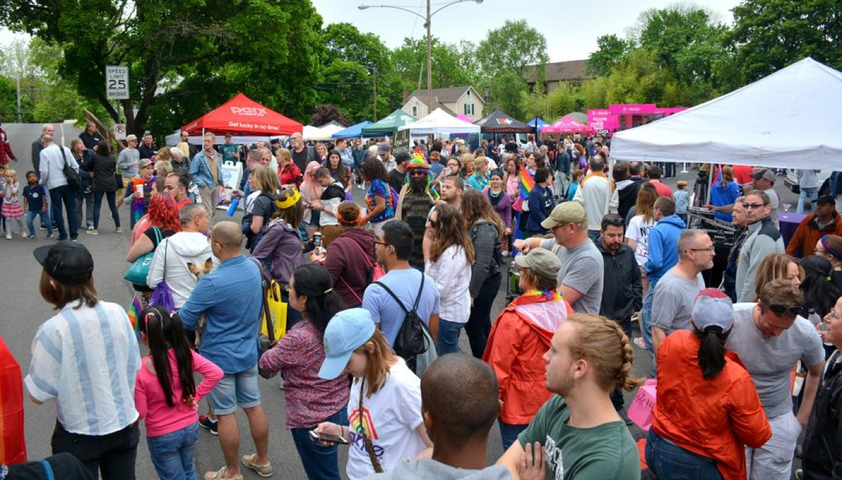
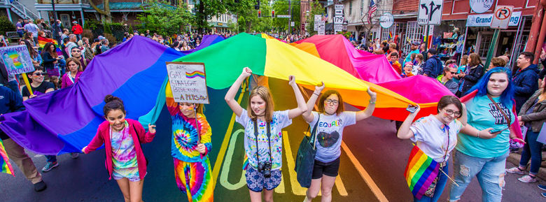
https://www.newhopecelebrates.com/about/volunteer

Slide 19
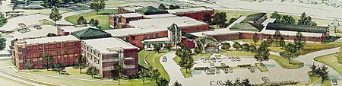
Neshaminy Manor
Warrington, PA
Mission: Non-profit nursing home that provides continuous physical, emotional and spiritual support for its elderly residents

Slide 20
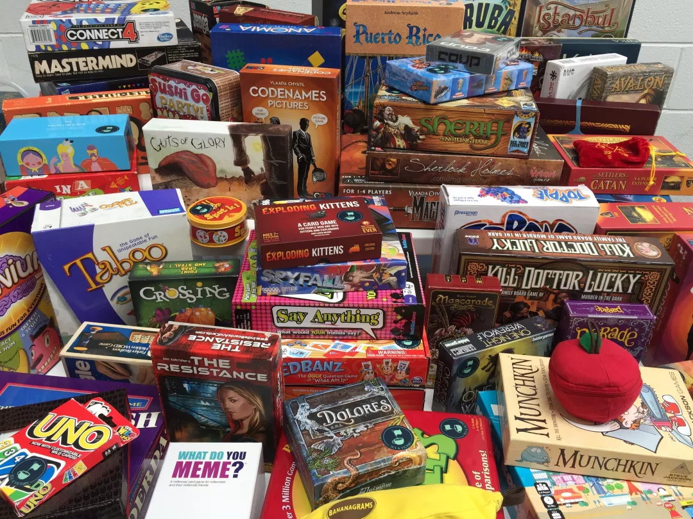
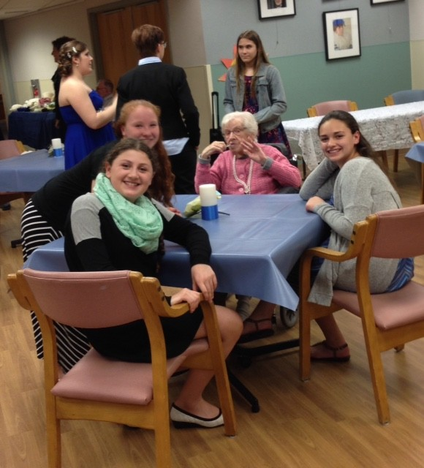
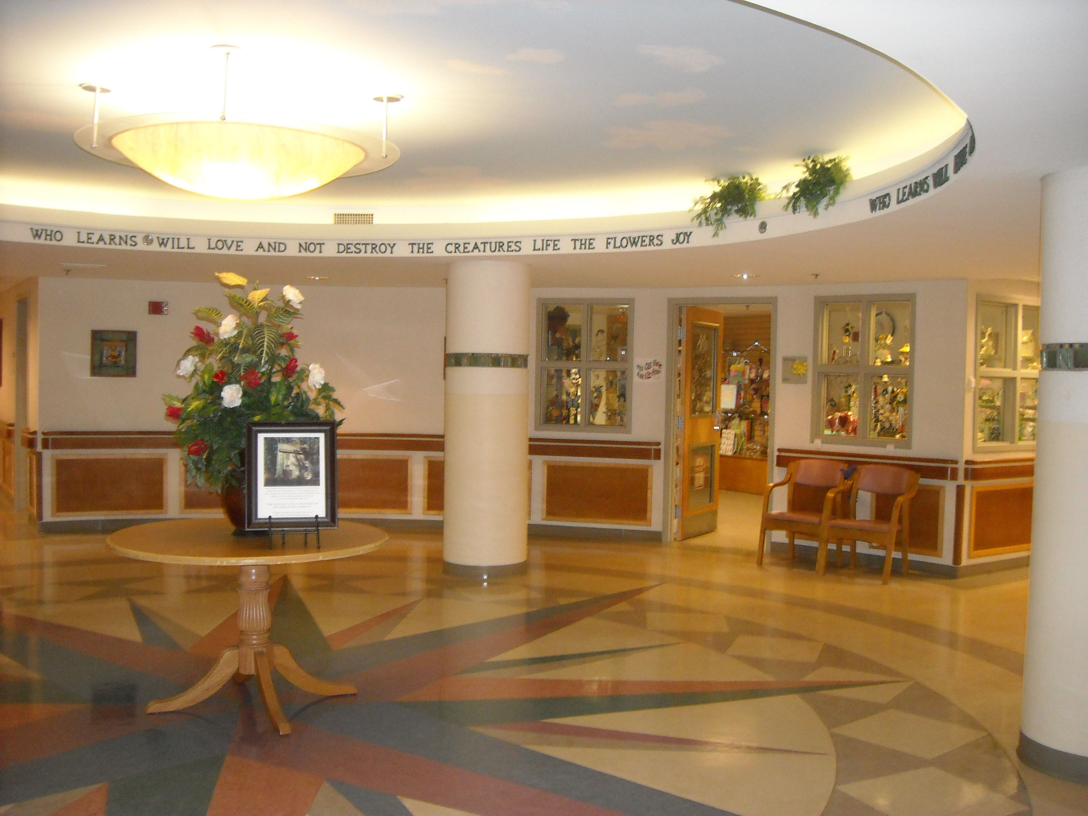
Who? -Interested students
What? -Board Game Day with Residents!
When? – MLK Day of Service
10-11:30 AM or 2 – 3:30 PM
Where? - Neshaminy Manor
Why? - To play board games and connect with the elderly in your community

Slide 21

Neshaminy Manor
Warrington, PA
Volunteer duties: work with residents during specific activities
Contact Information for the Neshaminy Manor: Heather O'Donnell HMOdonnell@buckscounty.org

Slide 22

The James Michener Art Museum
The James A. Michener Art Museum collects, preserves, interprets and exhibits American art, and promotes the work of nationally and internationally known Delaware Valley artists of all eras and creative disciplines. The museum presents exhibitions that explore a variety of artistic expressions and offers diverse educational programs that develop a lifelong involvement in the arts.

Slide 23
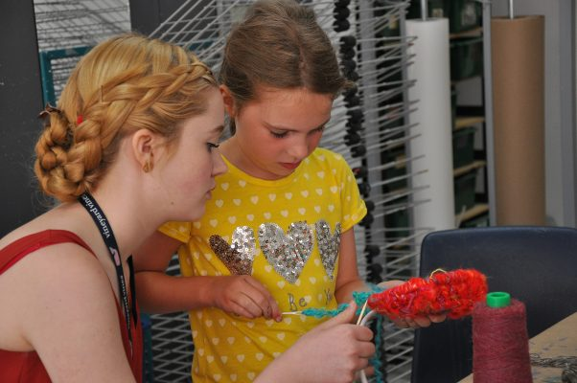
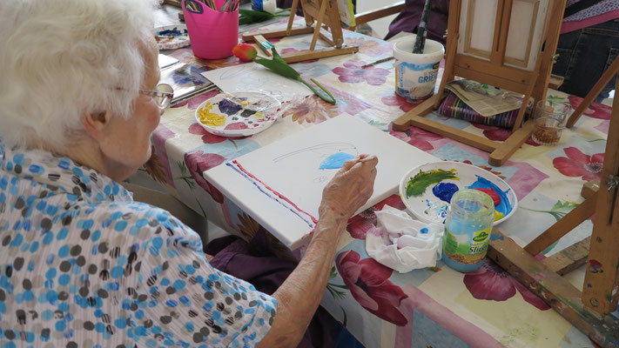
Counselor In Training Program
Art For All

Slide 24
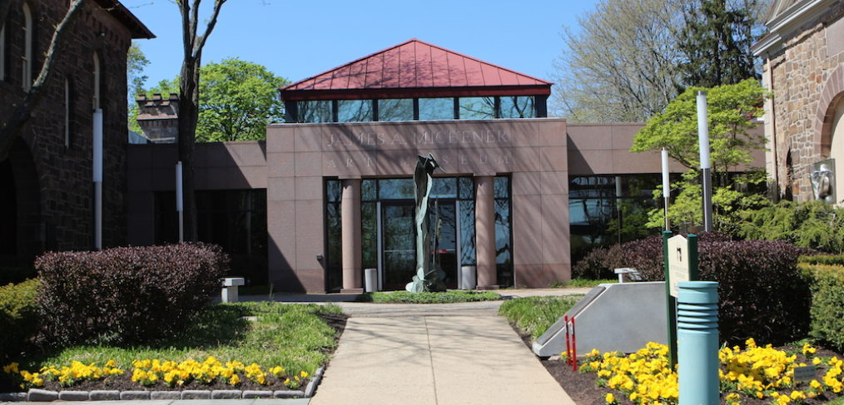
Contact: Ruth Anderson randerson@michenerartmuseum.org

Slide 25

Our Mission:
Almost Home Dog Rescue is a non-profit organization that works to save the lives of homeless dogs suffering in high-kill shelters. AHDR does not have a facility of its own. All of the dogs saved from shelters live in foster homes, where they remain until placed in their Forever Home. We strive to match each dog with the right new home, and have a high success rate of adoptions.

Slide 26
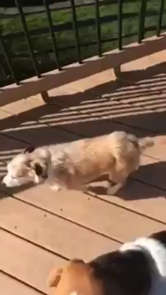

Slide 27


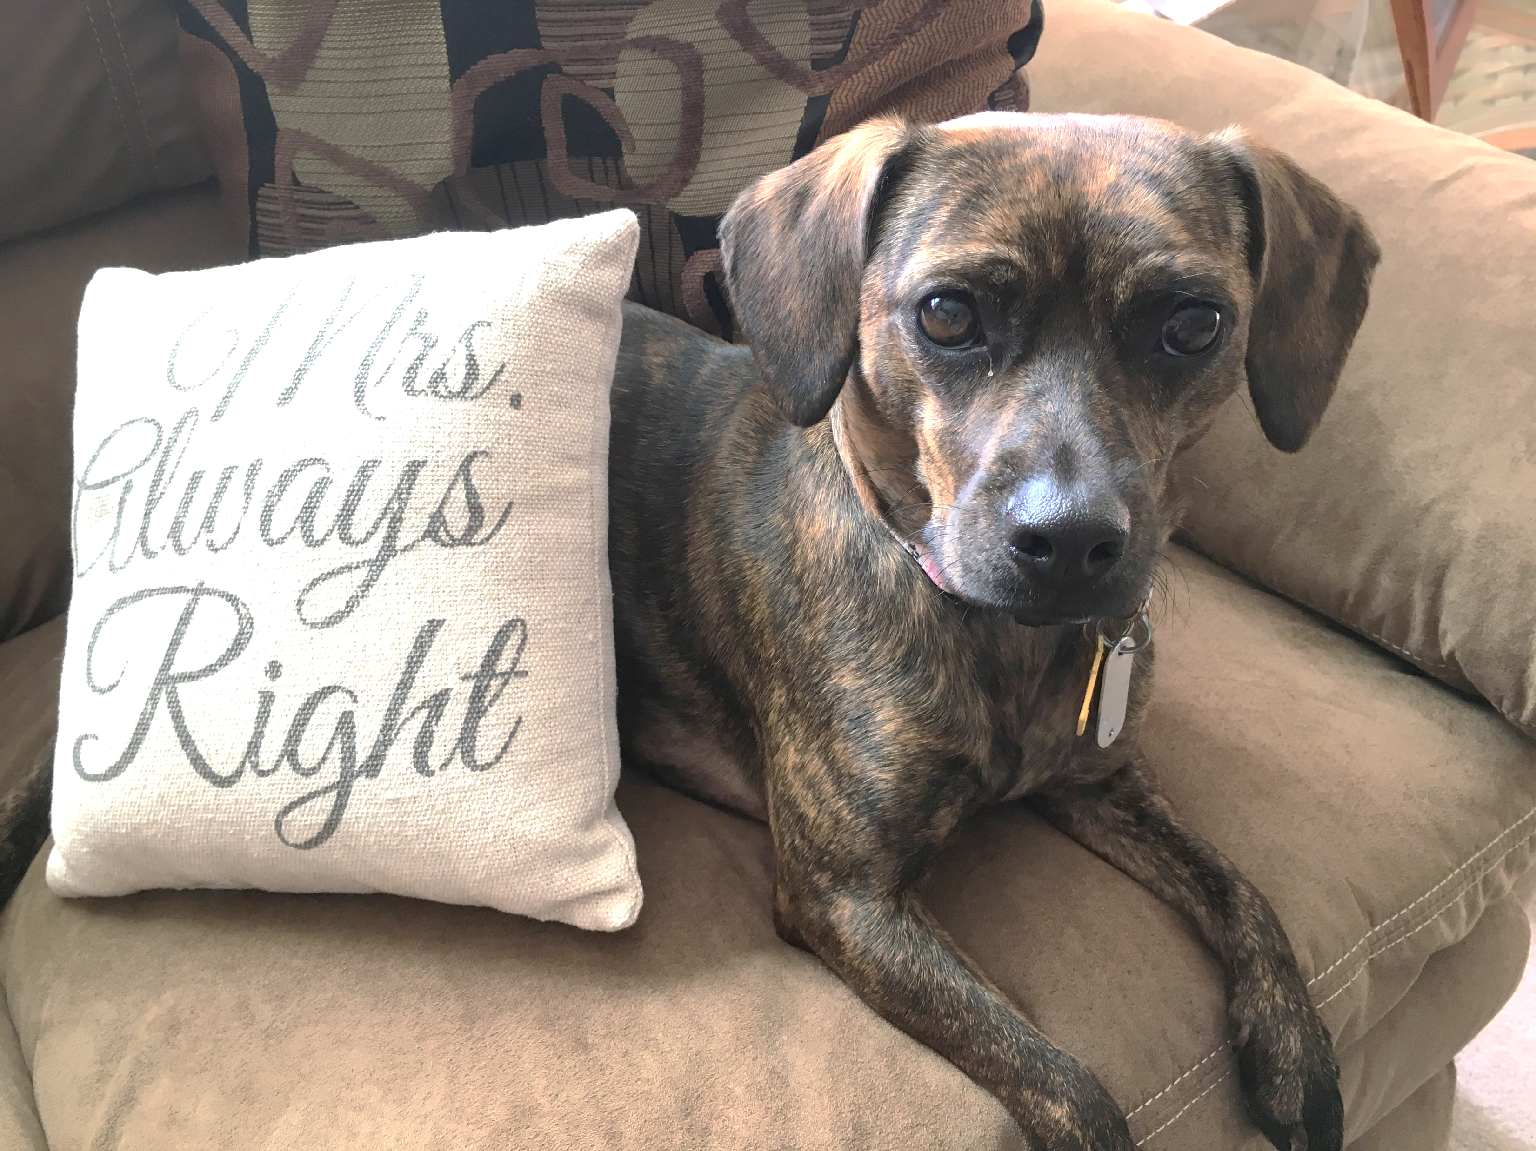

Penny
If you are interested in volunteering with this organization, you can visit their website at www.AHDR.org or contact them via their social media pages. They are always in need of donations and volunteers to help in various ways.
You and your family can foster or even adopt a dog! If that is more than you’re ready for, you can also help out at
  Meet and Greets
  Community Days
  BINGO and Fundraisers
  Pet Fairs

Slide 28
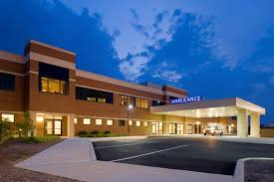

Doylestown Hospital Volunteer Service
Call the Volunteer Office (215) 345-2204.
Volunteers serve in more than 80 different areas in the hospital, including Patient Transport, Doylestown Hospital's Gift Shop, Snack Bar and Information Desks..
The Doylestown Hospital family treasures its Volunteers.
CALL NOW!

Slide 29
Peace Valley Nature Center
The goals of Peace Valley Nature Center are to bring about a better understanding and respect for nature’s laws and balances through “hands on” earth education experiences and to provide a place where County citizens can enjoy the peace and beauty of a natural area.

Slide 30
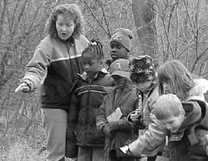

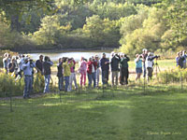

Slide 31
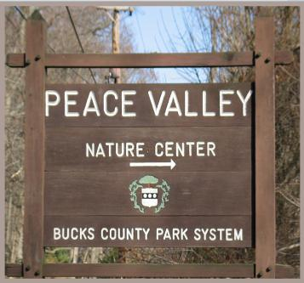
Volunteer Opportunities Include outdoor help such as trail keepers, gardeners and summer assistants. Indoor volunteer opportunities include storekeepers, receptionists, and library assistants. Other volunteer positions are available such as fundraising events, community events representatives, and more!
For more information
about volunteering, contact:
Jennifer Conway-Ianacone
Assistant Naturalist/ Volunteer Coordinator
(215) 345- 7860 (ext 106) jmconway-ianacone@ buckscounty.org

Slide 32

Ann Silverman Health Clinic
Our Mission:
We provide free medical care, dental care and social services to low-income, uninsured members of our community. Our clinic is made possible by volunteer physicians, dentists, nurses and support staff; by Doylestown Hospital, which contributes facilities, and other support services; and by generous donations from the community.

Slide 33

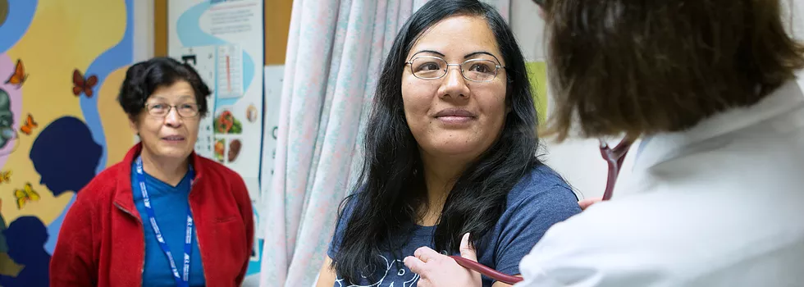
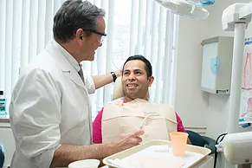
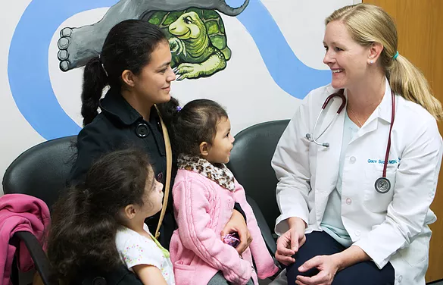

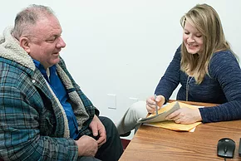

Slide 34
Ann Silverman Health Clinic
If you are interested in volunteering with this organization, you can visit their website here or call them (215-345-2260). While most of their volunteer opportunities seem to be geared towards medical professionals, social service workers, or behavioral health specialists, there are other ways to help:
  Filing
  Photocopying
  Mail Preparation
  Fundraising

Slide 35
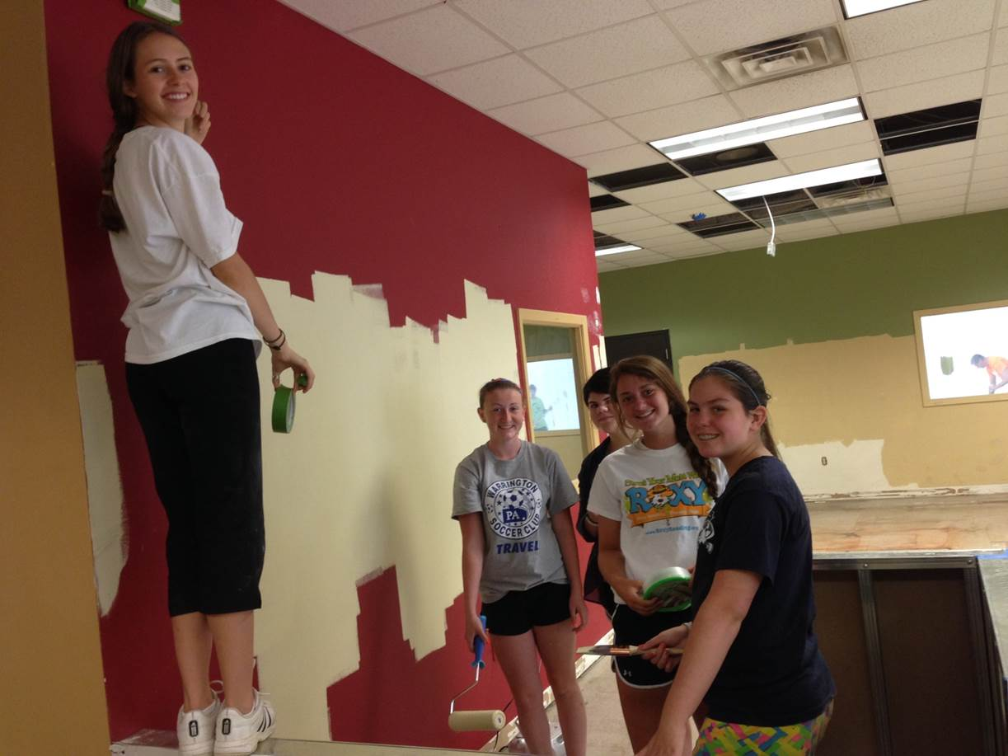
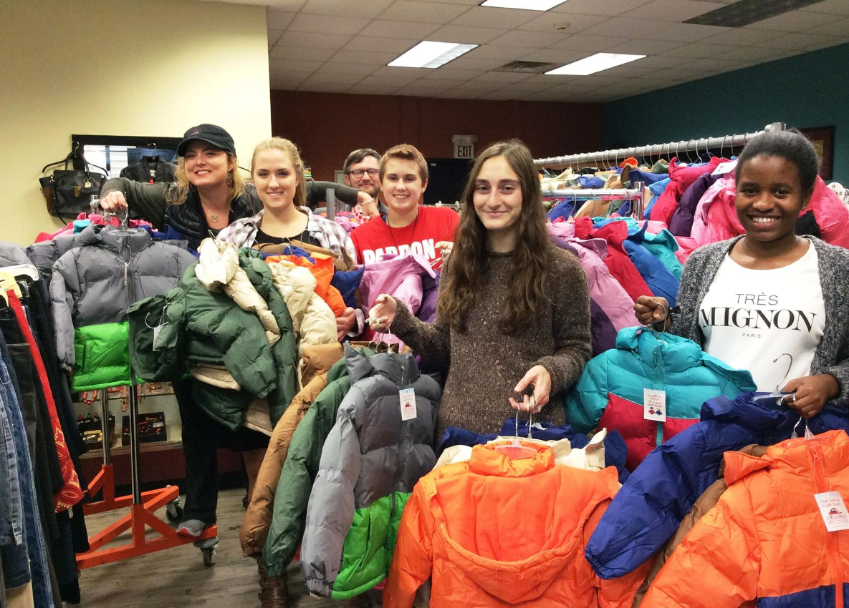
A Woman’s Place
1281 Almshouse Rd.
Doylestown, PA 18901
215-343-9241
A Woman's Place is a community-based social change organization committed to the empowerment of women and to domestic violence for all.

Slide 36
Opportunities for Teen Volunteers
Babysit the children living in the Shelter
Serve as a Camp Counselor at the Peace Works Summer Camp
Help with fundraising and special events
Full Swing Thrift Store: assist with sorting donations, creating store displays, and providing customer service
Organize a Donation Drive

Slide 37

Bucks County Housing Group
What does Bucks County Housing Group do? BCHG touches the lives of over 57,000 members of our community every year through our homeless shelters, affordable housing units, food pantries, and counseling services. Navigate using the buttons below to learn about our various services, upcoming events, and resources that can potentially be of use to you.

Slide 38
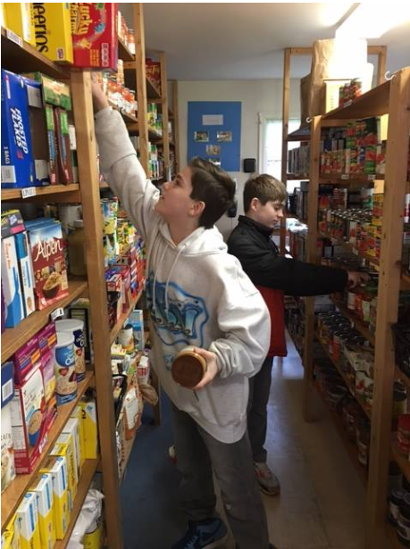
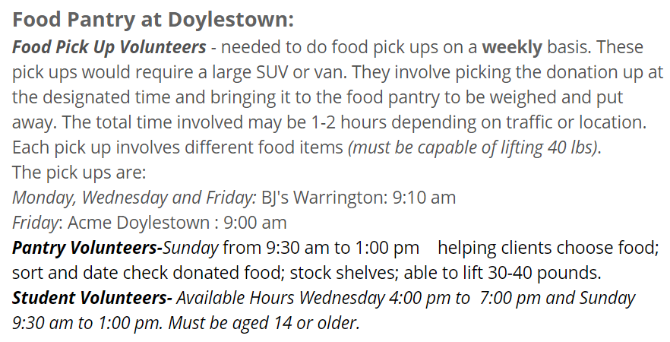

Slide 39
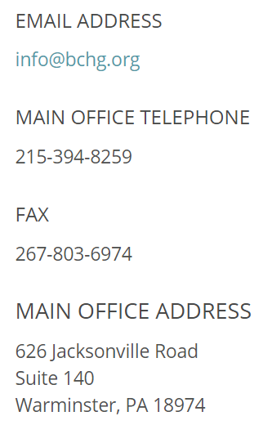
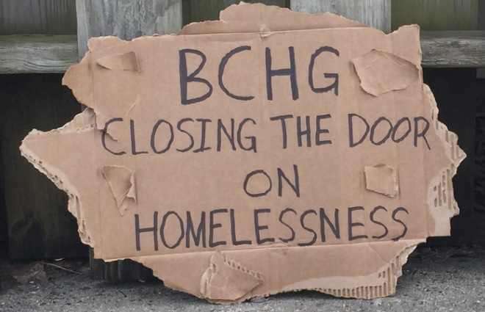

Slide 40

Special Equestrians
Therapeutic Riding Center
Warrington, PA
Mission: To improve the physical, mental & emotional well being of individuals with disabilities through the equine experience.

Slide 41
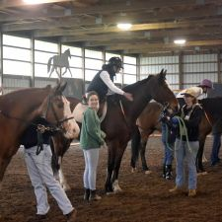
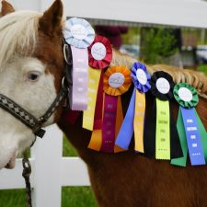
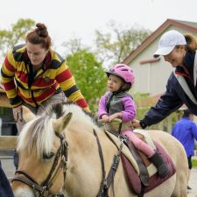

Slide 42
Special Equestrians
Therapeutic Riding Center
Warrington, PA
Volunteer duties: include leading horses in lessons, walking alongside horses in lessons as a side-aide, horse care, barn and facility maintenance, office help, marketing, and special events. No prior experience is necessary. Students must be 14+
Contact Information for S.E. www.specialequestrians.org

Slide 43

Bucks County Council on Alcoholism & Drug Dependence
MISSION:
To reduce the impact of addiction and related health issues on individuals, families and the entire community through prevention, intervention and recovery support services.
CONTACT:
Beth Elliott
215-489-6120 x4
belliott@bccadd.org
VOLUNTEER OPPORTUNITIES:
Recovery coaches
Life skills workshop facilitators
Community event volunteers
Cub reporter to write newsworthy stories
Meditation & reflection garden design team

Slide 45


